Slide 1
Security Attacks: Risks and Impact on the CIA Security Goals
GADI REDDY PRAKASH
Register Number: 192365026
Subject: CRYPTOGRAPHY AND NETWORKING
Course Code: CSA5116
Notes:
my name is GADI REDDY PRAKASH and my register number is 192365026 and my subject is CRYPTO GRAPHY and neyworking the course code is CSA5116 according to that addd the front page in the slide

Slide 2
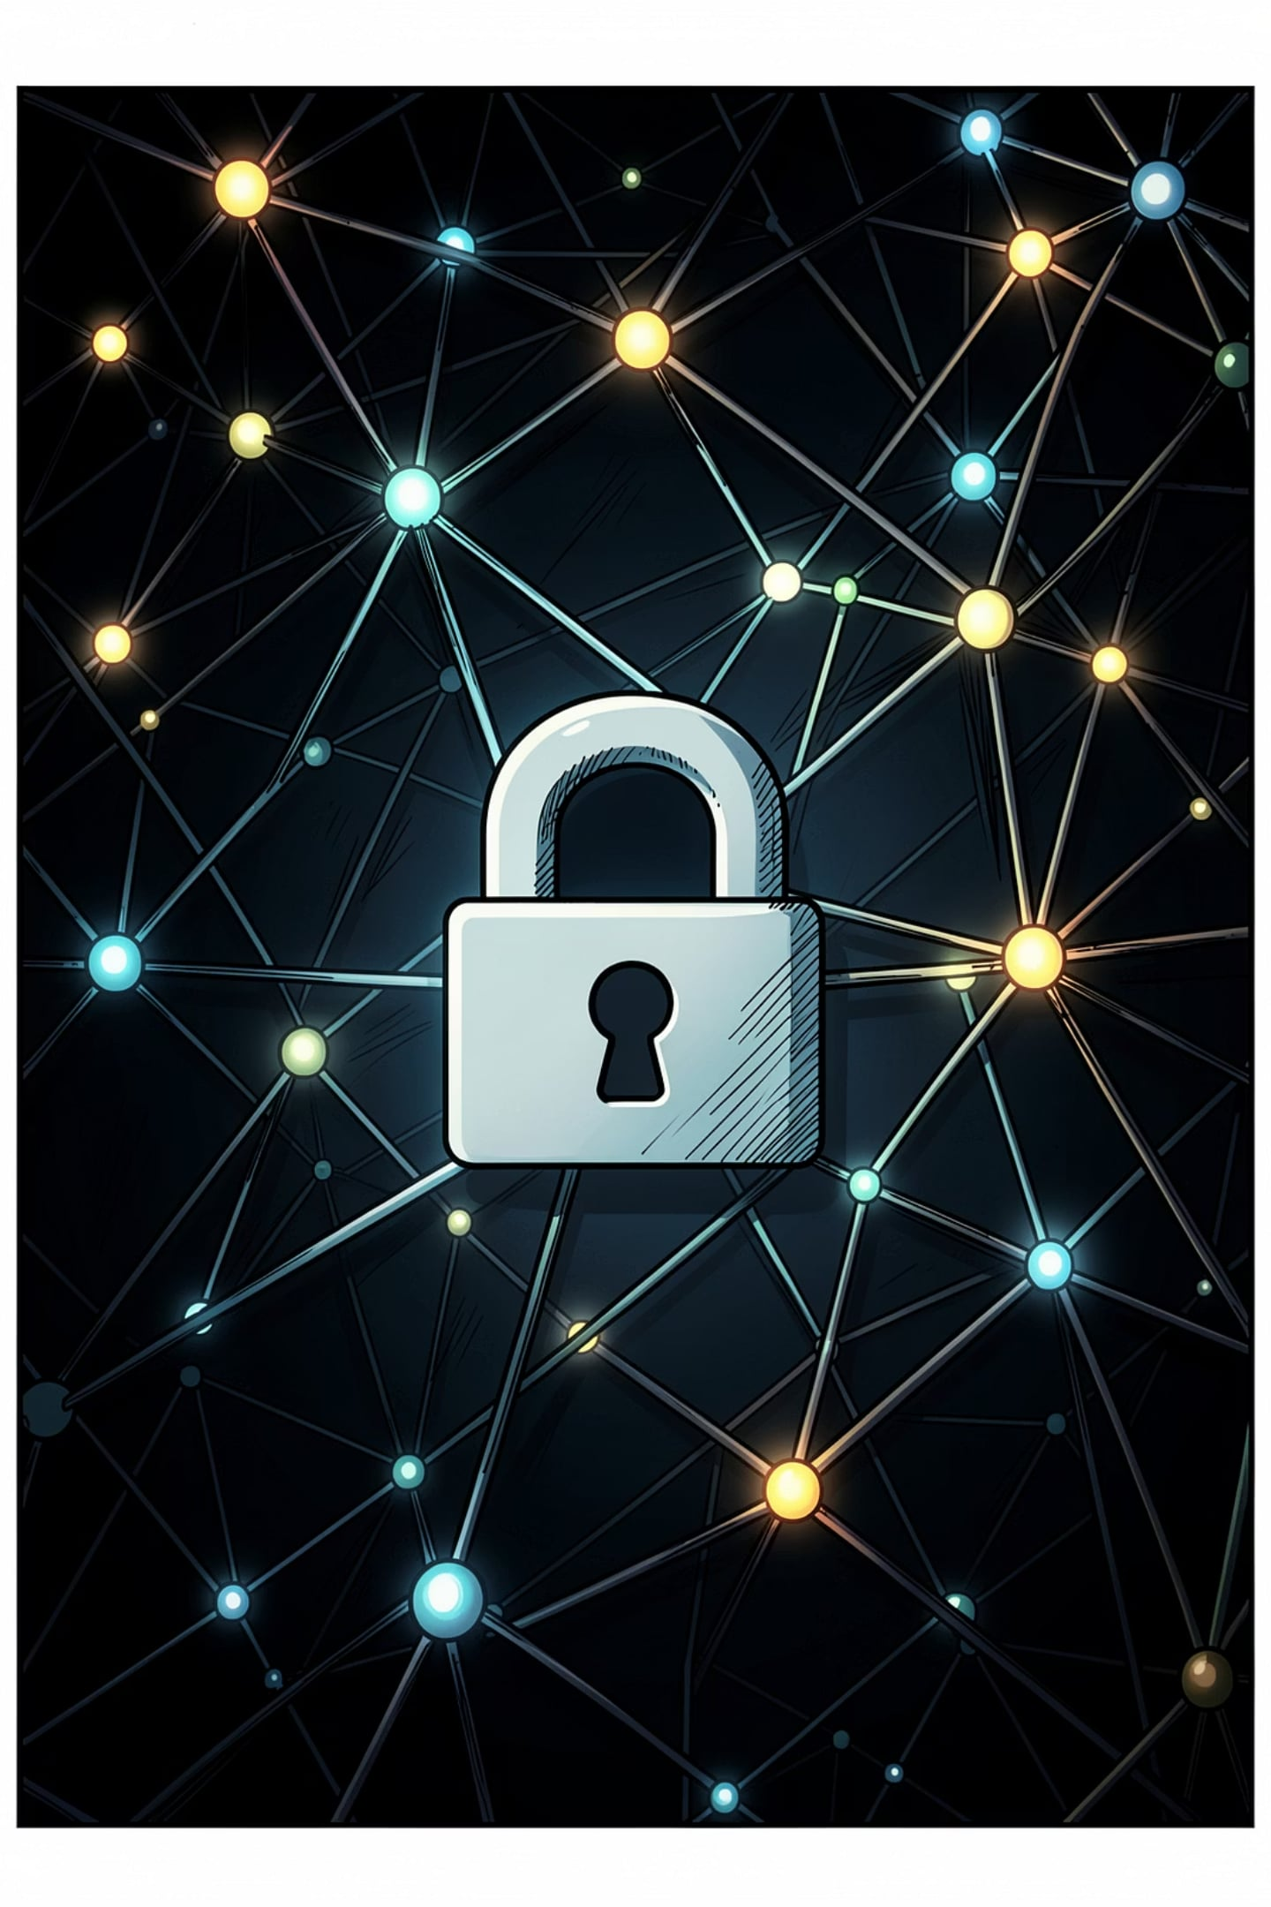
Security Attacks: Risks and Impact on the CIA Security Goals
Concise guide to threat evolution, real-world examples, and how attacks compromise Confidentiality, Integrity, and Availability — plus practical countermeasures for resilience.

Slide 3
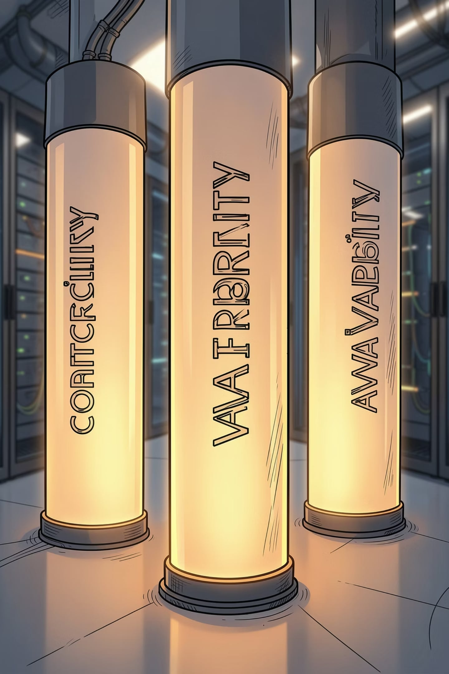

The Foundations of Security: The CIA Triad
Confidentiality
Protect data from unauthorized disclosure — impacts: identity theft, loss of competitive advantage, regulatory fines.
Integrity
Ensure data remains accurate and unaltered — impacts: fraudulent transactions, corrupted records, damaged trust.
Availability
Keep systems and data accessible to authorized users — impacts: downtime costs, operational disruption, safety risks.
Theme accent: #FF7047 used across visuals for emphasis.

Slide 4
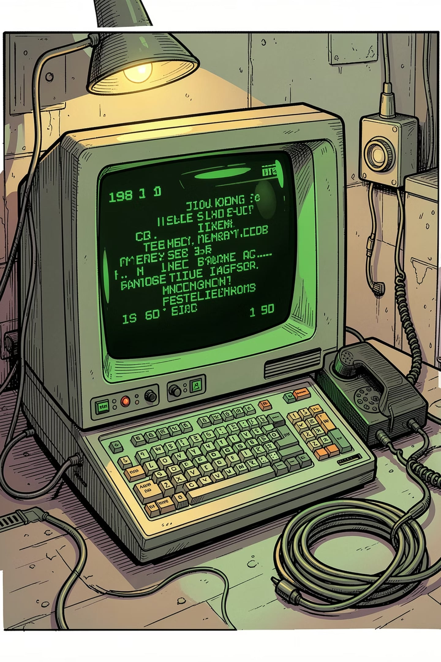
The Early Era: 'WarGames' Mindset (1960s–1980s)
Networks and remote terminals emerged; culture glamorized exploration. Early attacks targeted weak physical access and modems — war dialing found open systems, enabling unauthorized logins and reconnaissance.
Typical Risks
Impact on CIA
Open modems, default passwords, unpatched systems
Confidentiality breached by snooping; integrity often intact but at risk; availability minimally affected but vulnerable.

Slide 5
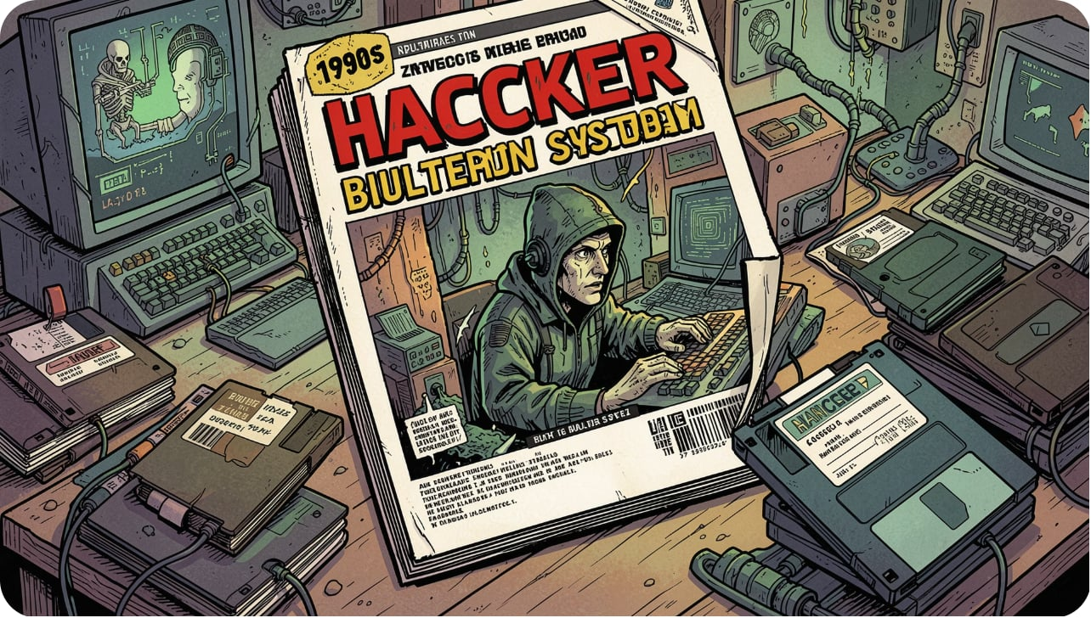
The Hacker Underground (1990s)
Communities and publications (e.g., 2600) shared techniques. Law enforcement responded — Project Sun Devil (1990) led to major raids and the first computer crime prosecutions.
by using BBS(Bulletin Board System)
Focus: perimeter penetration, social engineering, simple data snooping
Real example: Early data exfiltration via dial-up and bulletin boards
Impact: Greater attention to legal frameworks and incident response

Slide 6
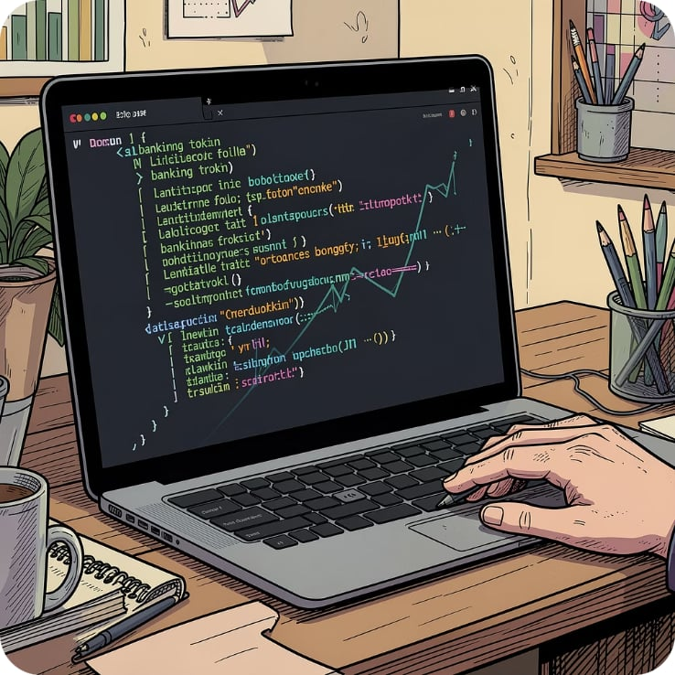
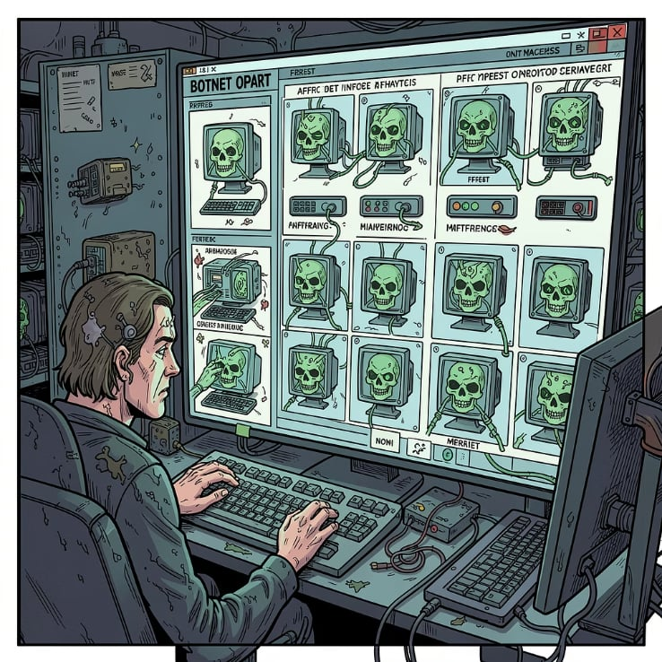
The Rise of Organized Cybercrime (2000s)
Attacks became profit-driven: botnets, rented access, and credential-stealing trojans. Attackers monetized compromised machines via spam, click fraud, and banking malware.
SilentBanker and Banking Trojans
Botnets & Spam Fleets
Focused on stealing online banking credentials — severe confidentiality loss and financial integrity breaches.
Compromised hosts used for mass mail, DDoS, and ad fraud — availability and reputation harmed.

Slide 7
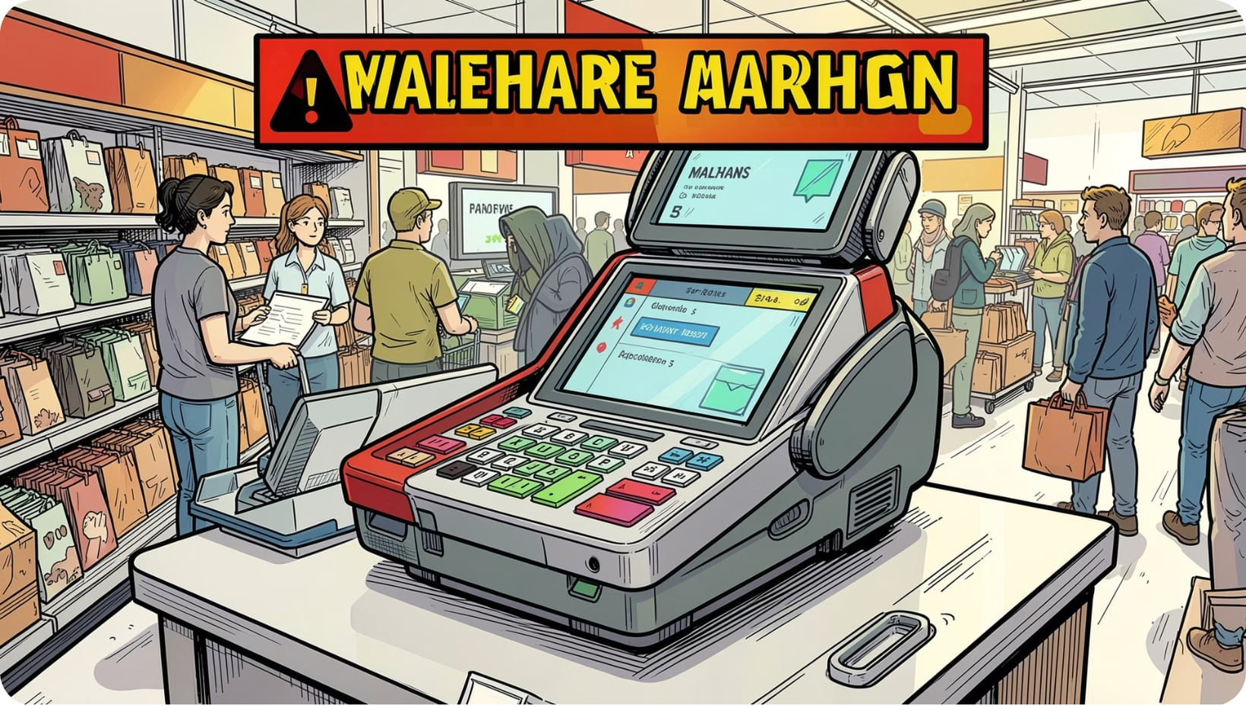
Targeted Breaches & Advanced Attacks (2010–2015)
Attackers shifted to long-term, stealthy intrusions targeting enterprises and critical infrastructure.
2013 Target breach — 140M customers' data exposed via vendor-access compromise (Confidentiality & Integrity)
Stuxnet — weaponized malware sabotaging industrial controllers (Integrity + Availability of physical systems)
Impact: Focus on supply chain security and lateral movement detection

Slide 8
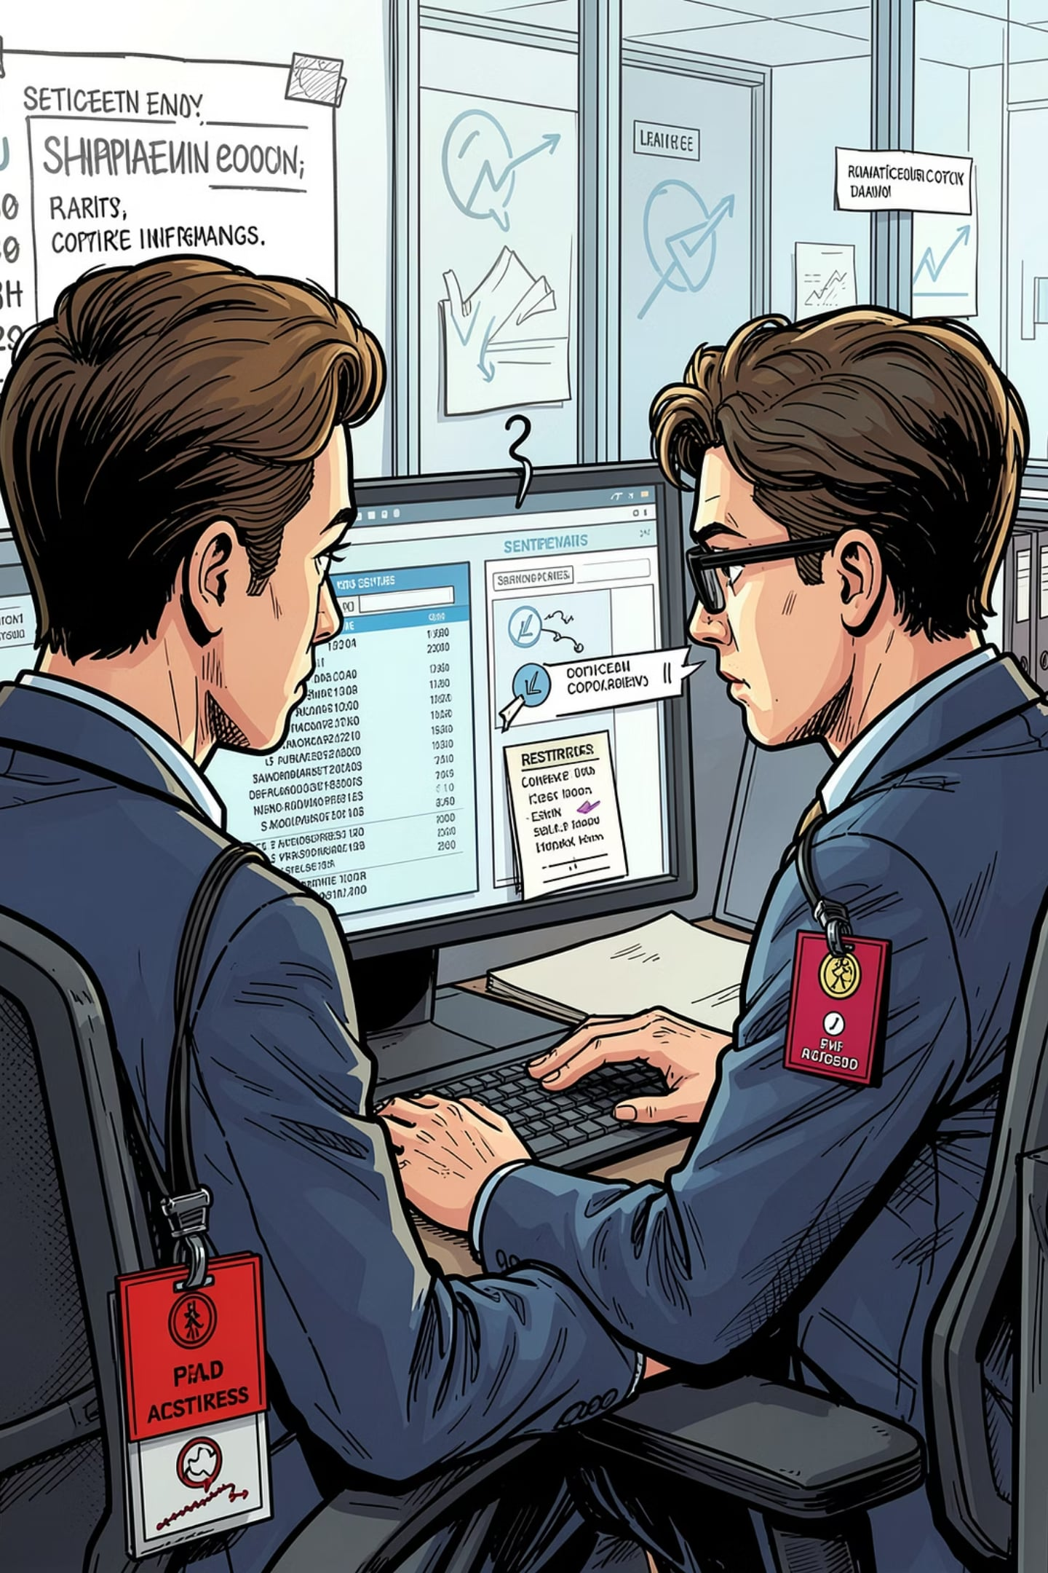

The Insider Threat: Hidden & High-Risk
Insiders exploit knowledge and access — often bypassing external defenses. Motivations include sabotage, IP theft, and financial gain.
Statistic context: a large proportion of financial cybercrimes involve insiders
Real scenarios: disgruntled employee copying customer lists; contractor misusing privileged credentials
Impact: Simultaneous breaches of Confidentiality, Integrity, and Availability depending on intent
Mitigation requires monitoring, least privilege, and behavioral analytics.

Slide 9
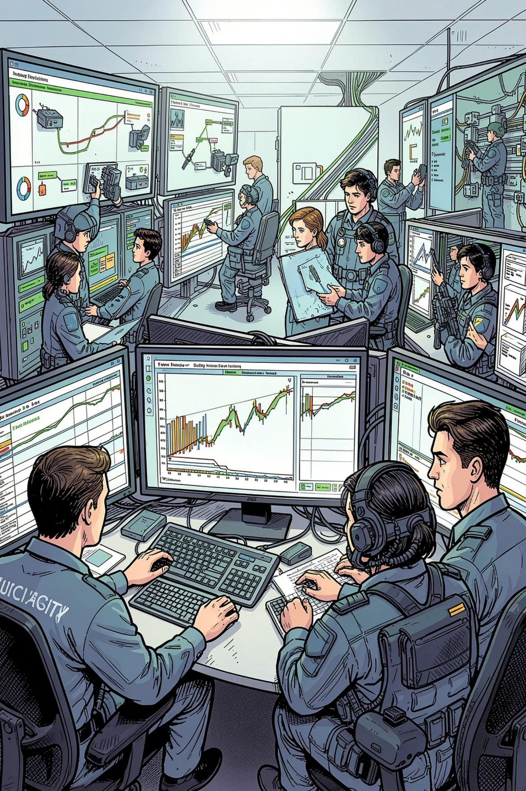
Strategic Countermeasures: Building Resilience
01
02
Preventative
Detective
Firewalls, strong authentication, encryption, patching, supply-chain controls — reduce attack surface and protect Confidentiality & Integrity.
SIEM, EDR, network telemetry, and anomaly detection to spot attacks early and preserve Availability.
03
Corrective
Incident response plans, backups, forensics, and crisis communication — restore systems and trust after breaches.
Combine technical controls with training, policy, and regular tabletop exercises to close human and process gaps.

Slide 10
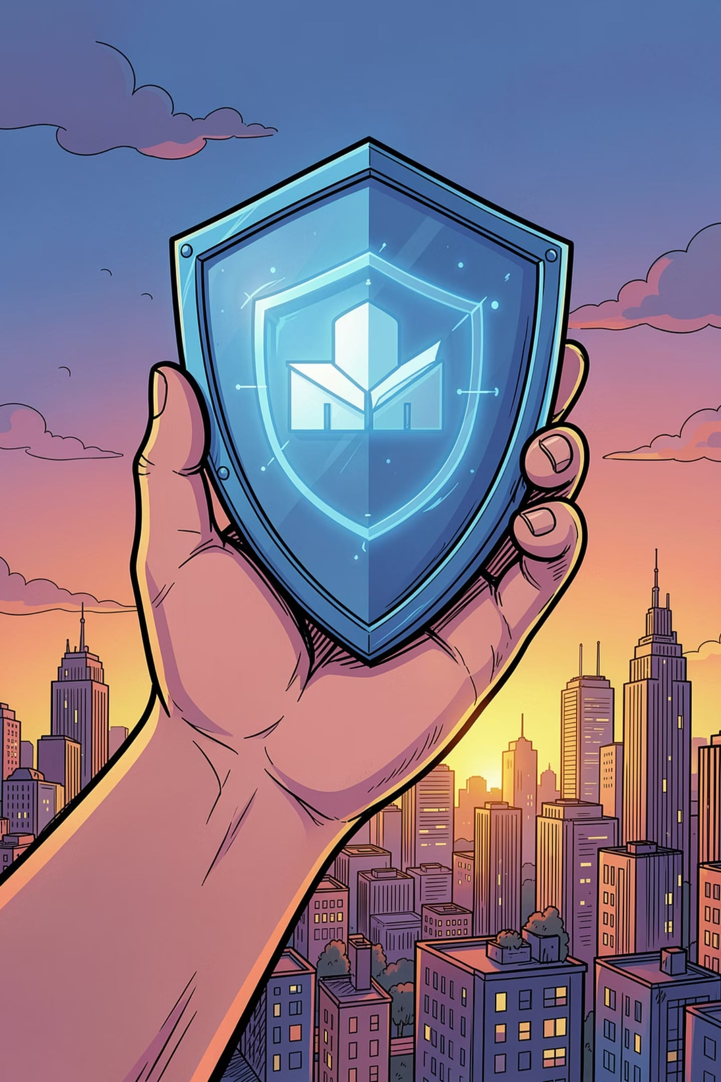
Conclusion: Security Is Ongoing
Security is not a one-time task. It needs attention all the time to help protect people, data, and systems.
Stay Alert
Watch for new risks and changes.
Keep Improving
Update security steps regularly.
Simple habits, clear plans, and steady follow-through make security stronger.

